Slide 1
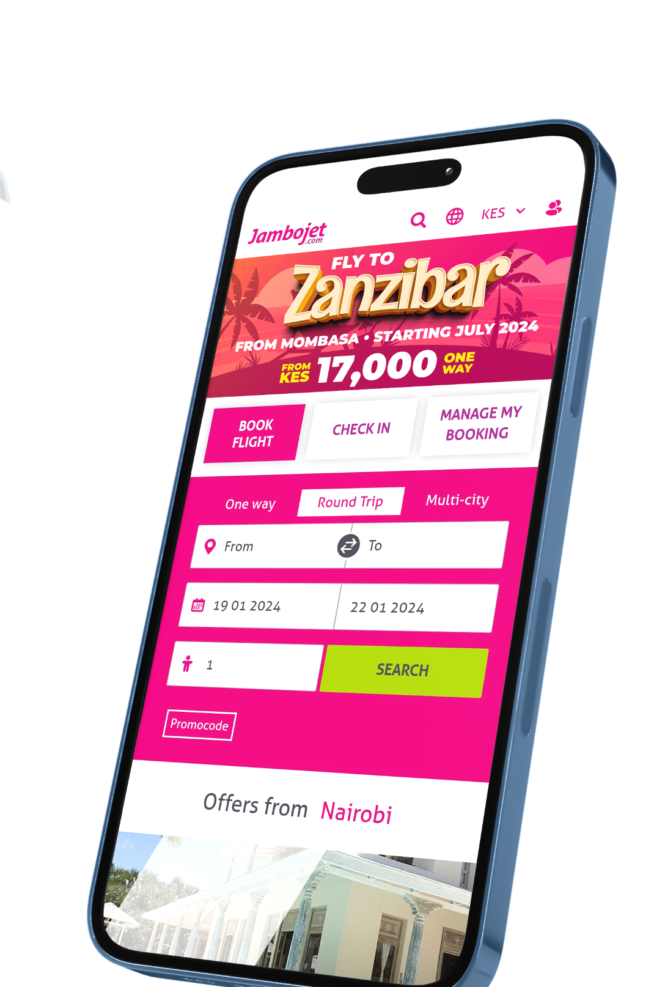


Web Traffic Prediction
for Enhanced Revenue.
By: Mwenda Mugambi | Frank Kiptoo | Yvonne Kamari | Julliet Iswana | Sylvester Magunda | Trevor Mwangi

Slide 2


Business Overview
Jambojet: Leading Low-Cost Airline in East Africa.
Key Strength: Preferred choice for cost-conscious travelers, emphasizing in the East African region.
Market Position: Dominant player in the aviation industry, known for budget-friendly and reliable air travel.
Market Share: 54+% in domestic air travel.
Awards: Won Africa's Leading Low-Cost Airline at the World Travel Awards in 2022 and 2023.
Diversification: Launched advertising product in 2018, leveraging their high-traffic website to boost revenue and advertiser satisfaction.

Slide 3

Problem Statement and Project Objectives
Jambojet seeks to maximize revenue and improve advertiser satisfaction by optimizing ad spaces.
Challenges include unpredictable web traffic patterns, affecting effective ad placement and leading to revenue loss and lower advertiser satisfaction.
This project focuses on revolutionizing ad placement through Advanced Time Series Forecasting.
This approach will enhance Jambojet's platform competitiveness and contribute to the broader industry's shift towards efficient online advertising solutions.

Slide 4

Data Collection and Understanding
The dataset used simulates the web traffic behaviors of websites such as www.jambojet.com. real-time time series data can be scrapped from Google Analytics
It considers their marketing campaigns, travel restrictions, and other industry factors that may influence web traffic.
The dataset consists of total users ('Simulated_Users') and new users ('Simulated_New_Users') per day, sourced from Google Analytics.
It captures daily fluctuations in user engagement, essential for precise forecasting and ad optimization.

Slide 5
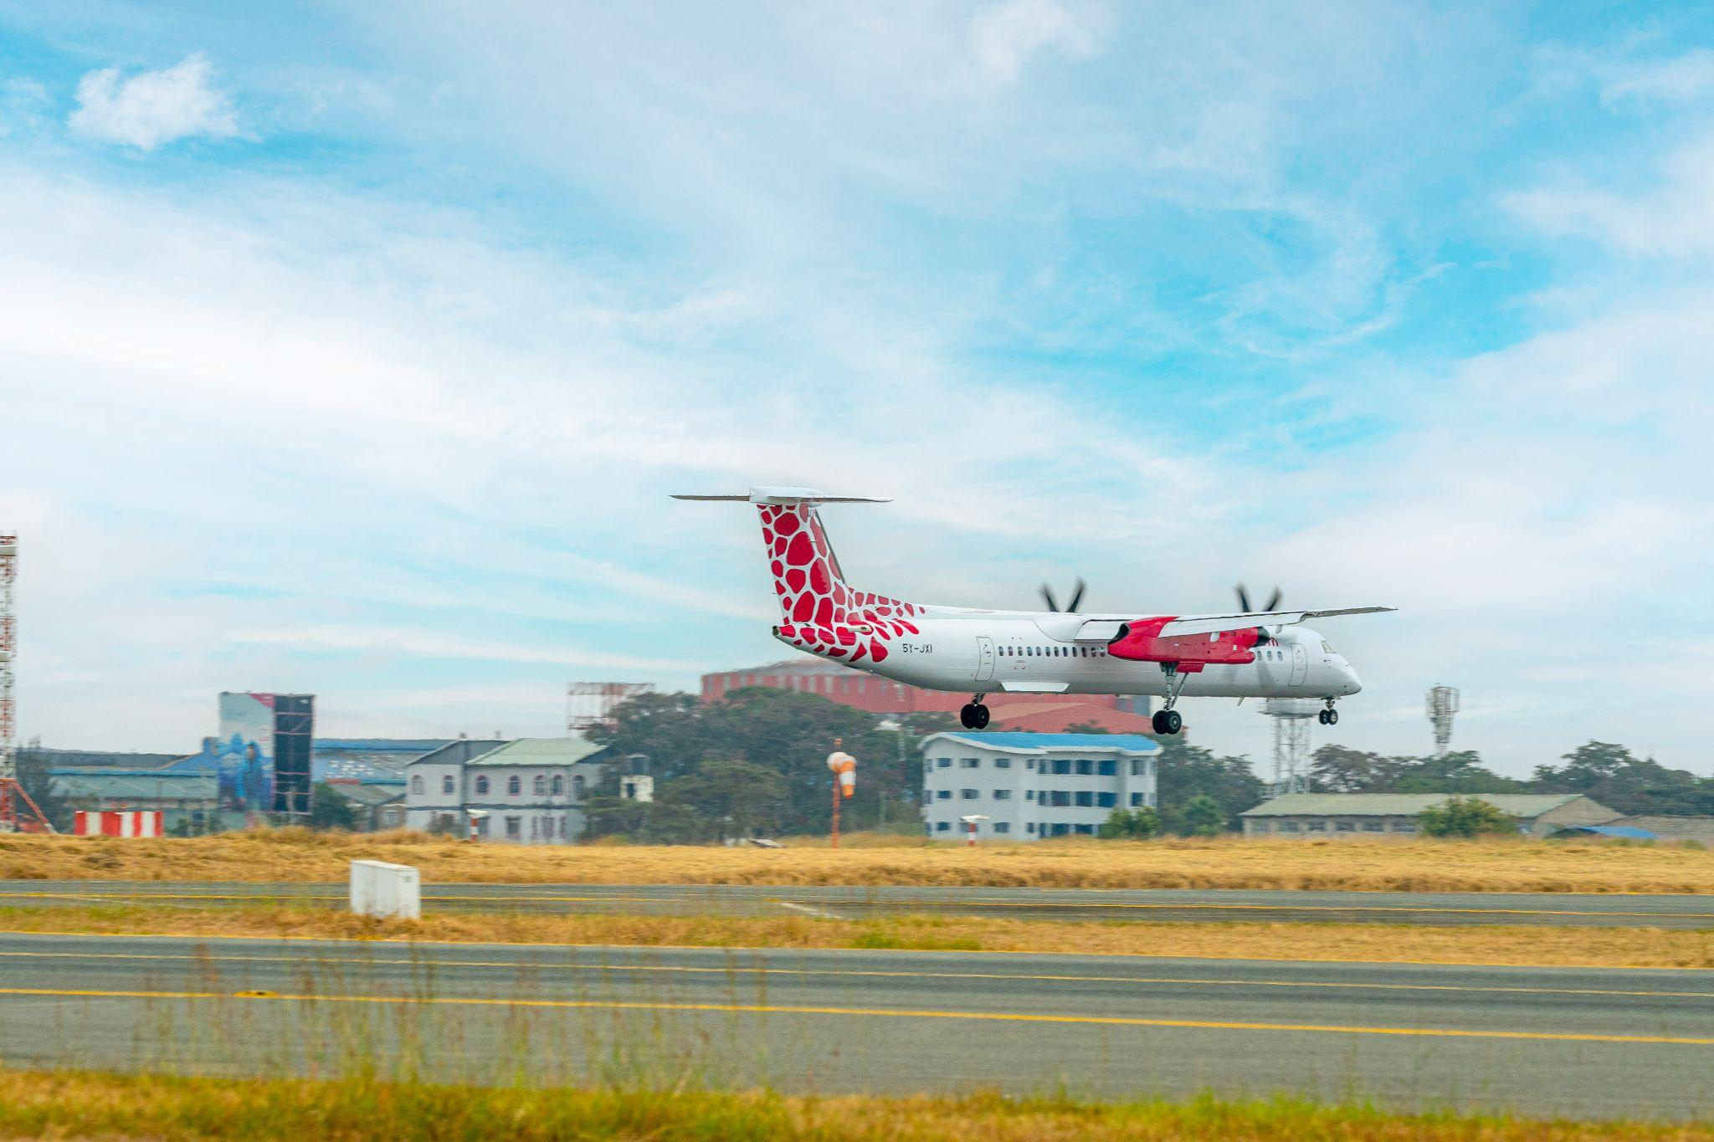

Success Criteria
Root Mean Squared Error (RMSE) is used to evaluate the accuracy of our time series forecasting models, specifically focusing on predicting daily total users and new users.
Achieving a low RMSE aligns with the broader goal of contributing to the sustainable development of Jambojet's online advertising ecosystem.

Slide 6
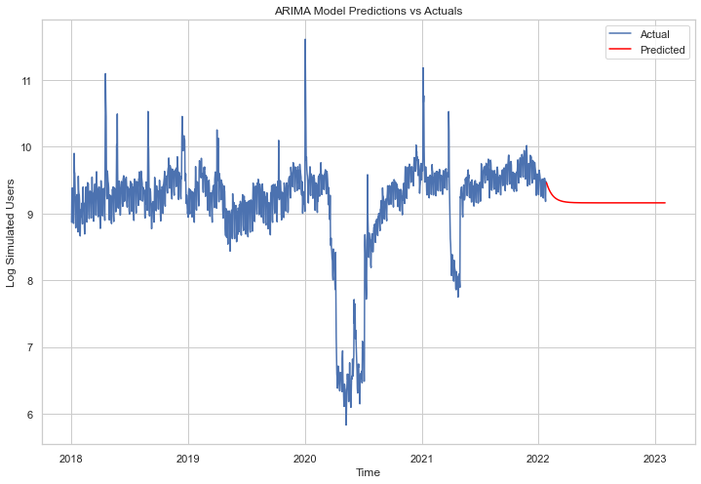
Baseline Model
Arima Model:
RMSE: 0.5976628
The RMSE is relatively low, but not the lowest among the models presented.

Slide 7
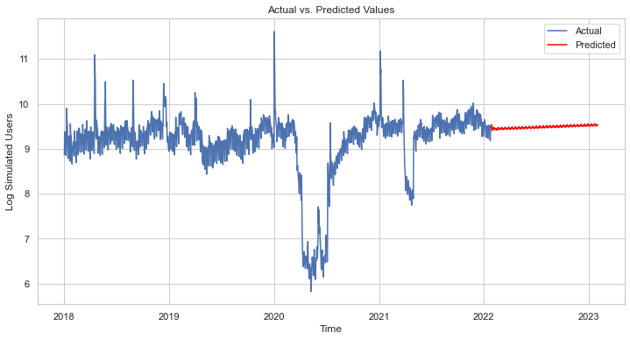
Model 4
Sarima Model:
RMSE: 0.327229
This model is a SARIMA model, which extends ARIMA by adding seasonal components.
The RMSE for this model is lower suggesting that the model is a good fit to the data.

Slide 8
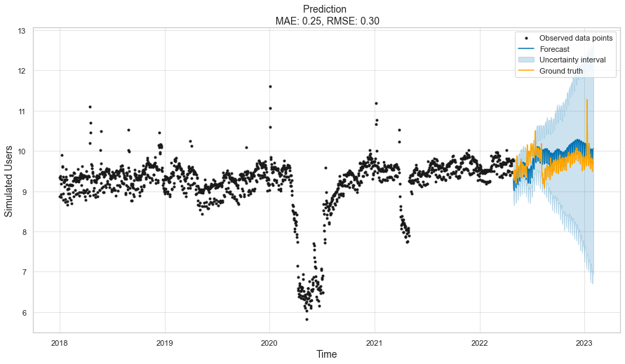
Best Performing Model
Facebook Prophet:
RMSE: 0.2965632
This is a an open-source forecasting tool developed by Facebook's Core Data Science team.
The RMSE is the lowest of the other models suggesting that it had the best fit to the data.

Slide 9
Conclusion
In conclusion, the evaluation of the different time series models applied to the dataset provides valuable insights into their performance.
While the PMDARIMA model (Model 3) offers a competitive RMSE close to that of SARIMA, its advantage lies in the automatic selection of model parameters, showcasing the effectiveness of the pmdarima package.
The ARIMA models (Models 1 and 2) also provide reasonable predictive capabilities, with Model 2, incorporating differencing, outperforming Model 1.
Considering the RMSE values, the Facebook Prophet model (Model 5) stands out as the most accurate among the evaluated models. Its lower RMSE suggests that Prophet is well-suited for forecasting the simulated user data in this particular scenario. It outperforms the traditional ARIMA and SARIMA models, as well as the auto_arima approach.

Slide 10

Recommendations
1. Facebook Prophet Model for Forecasting:
Implement the Facebook Prophet model for accurate web traffic predictions.
Use forecasts to identify peak traffic periods for dynamic ad placement and pricing.
2. Marketing and Communication Strategy:
Align marketing with Jambojet's event calendar, focusing on peak travel times and holidays.
Plan campaigns in advance to build anticipation.
Use social media and email marketing for promoting deals during low seasons.
3. Promotion and Event-Driven Marketing:
Coordinate ad campaigns with peak travel periods and promotional events.
Partner with tourism boards and travel agencies for joint promotions.
Use real-time marketing strategies during high traffic periods.
4. Segmentation and Targeted Advertising:
Analyze different user segments for tailored advertising.
Offer personalized promotions, like targeting international travelers during winter.

Slide 11

Cont..
5. Dynamic Ad Space Pricing:
Adopt a dynamic pricing strategy based on seasonality trends.
6. Advertiser Dashboard and Real-Time Insights:
Introduce a dashboard for real-time ad performance and web traffic insights.
Allow advertisers to adjust campaigns based on data-driven insights.
7. Enhancing User Experience:
Optimize the website for peak traffic times to prevent slowdowns.
Incorporate user feedback for continual improvement.
8. Response to External Factors:
Monitor external factors impacting web traffic.
Develop contingency plans for unexpected travel pattern changes due to global events.

Slide 12
THANK YOU
By: Mwenda Mugambi | Frank Kiptoo | Yvonne Kamari | Julliet Iswana | Sylvester Magunda | Trevor Mwangi

